Slide 1
on Netflix Closing Stock price
Univariate Time-Series Forecasting
By: ML7_T2120

Slide 2
Background study
well-Known
issue
Predicting stock prices is on the rise
Efficient Market Hypothesis
“Stock prices have a random walk. Therefore, it is impossible to forecast its future behavior”
No significant evidence on the assumption.
Investors uses statistical approach to predict stock close price
Tedious & time consuming
Current method are not suitable with huge amount of data
Usage of Traditional methods
Netflix
Subscription based streaming service founded in 1997
Global service with 200 million subscribers
Many studies have been made on predicting closing price of stock but none to be found using Netflix dataset

Slide 3
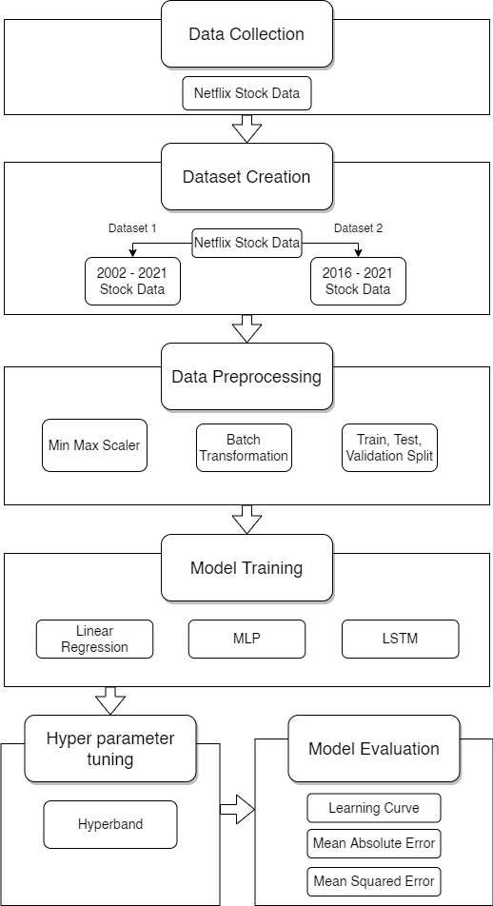
Project workflow
Data Collection: Retrieve data from Kaggle
Dataset Creation: Create new 2016 dataset
Data Preprocessing: Identify missing data, standardize values & explore distribution
Model Training: Training Linear Regression, MLP, LSTM using both dataset
Hyperparameter Tuning: Identify optimal architecture and values for each parameter
Model Evaluation: MAE, MSE and learning curve

Slide 4
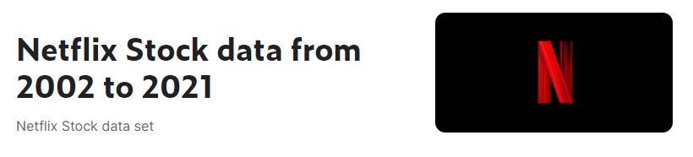


Netflix stock price dataset
Retrieved from Kaggle
Data collected from Yahoo Finance
From 23/05/2002 to 30/09/2021
CSV file of 335.65 kB
4874 rows by 7 columns
Attribute | Description | Data Type | Range of Values
Date | Date of the stock market operates | String | 23th May 2002 to 30th September 2021
Open | Stock price when the market opens | Continuous | 0.38 to 608
Close | Last price of stock before market closes | Continuous | 0.37 to 610
Adj Close | Adjusted closing price after accounting corporate actions | Continuous | 0.37 to 610
High | Highest price a stock was traded on that day | Continuous | 0.41 to 619
Low | Lowest price a stock was traded on that day | Continuous | 0.35 to 608
Table 1: Attributes Details

Slide 5
Data pre-processing
Identifying Null values
Rem0ve unused features
Data type conversion
Date object to datetime type
No missing values were detected
Univariate forecasting uses one feature only
Normalization
Create new dataset
Using Min-Max scaler to standardize closing price values
Closing price of stock in early years were too different than current years

Slide 6
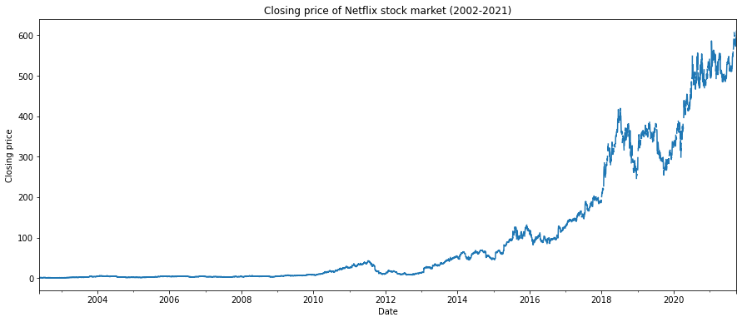
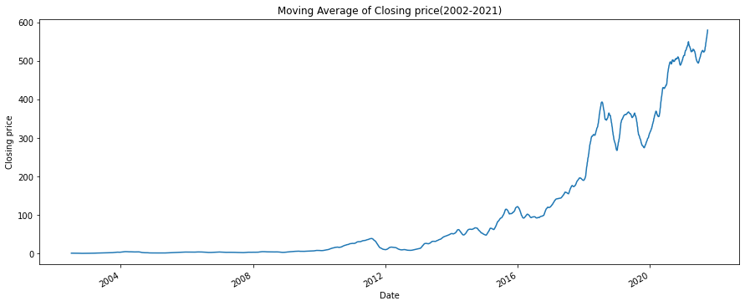
Exploratory data analysis
Closing price was less than $200 in early years
Stock price gradually increased from 2016
Increasing popularity of Netflix original series
Covid-19 pandemic
Booming of streaming services
Gaps between data ᠆ No data recorded on weekends due to closed market

Slide 7
Machine learning models
Linear regression (LR)
Multi layered perceptron (MLp)
Long-short term memory (lstm)
Regression machine learning model
Combine with neural network architecture
Type of neural network model that consist of at least 3 layers
Trained with backpropagation algorithm
Type of recurrent neural network.
Manages stored memory in the cell by using gates (forget gate, input gate, output gate)
Initial LR model
1 layer with 1 neuron + linear function
Flatten layer
1 output layer
Adam optimizer + Learning rate of 1e-5
Run in 100 epochs
Initial MLP model
4 dense layers of 50 neurons + sigmoid function
1 layer with 10 neurons + softmax function
Flatten layer
1 output layer
Adam optimizer + Learning rate of 1e-7
Run in 100 epochs
Initial LSTM model
4 dense layers of 100 neurons + linear function
1 output layer
Adam optimizer + Learning rate of 1e-5
Run in 100 epochs

Slide 8
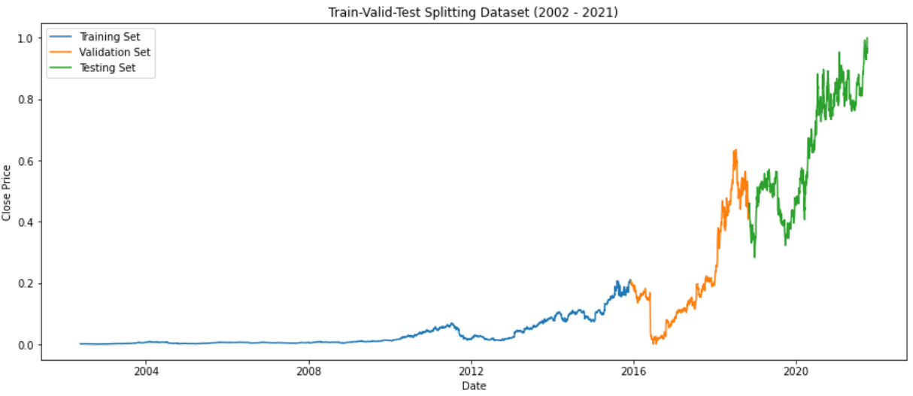
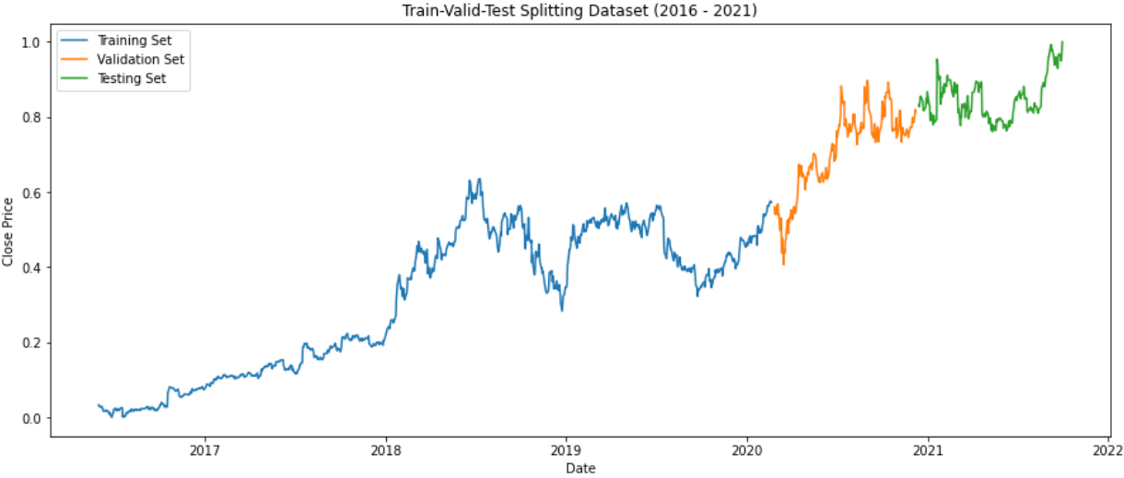
Data splitting & Model training
Create a new ‘2016 dataset’
The closing price of early years are too different with the current pricing.
Unsuitable to use insignificant data to predict current situation
Each dataset splits into batches with window size of 5 days
Each dataset is divided into 3:
First 70% ㇐ Training data
15% ㇐ Validation data
15% ㇐ Testing data
Original dataset
2016 dataset

Slide 9
Hyperparameter Tuning
Hyperband
By Keras Tuner
Set range of values for a specified parameter based on its data types
Determine the optimal value that gives the lowest Mean Absolute Error and Mean Squared Error
Different parameters were tuned for each model
Linear Regression Tuned Parameters
MLP Tuned Parameters
LSTM Tuned Parameters
Parameters | Method | Range Values
Learning Rate | hp.Choice | 1e-2, 1e-3, 1e-4
Parameters | Method | Range Values
Activation Function | hp.Choice | sigmoid, softmax, relu
Number of neurons | hp.Int | 50 - 200
Number of layers | hp.Int | 1 - 5
Learning Rate | hp.Choice | 1e-5, 1e-6, 1e-7
Parameters | Method | Range Values
Number of neurons | hp.Int | 10 - 100
Dropout | hp.Float | 0.0 - 0.5
Learning Rate | hp.Choice | 1e-2, 1e-3, 1e-4

Slide 10
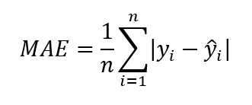
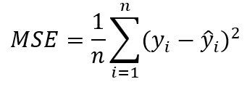
Performance metrics
MEAN absolute ERROR (MAE)
MEAN squared ERROR (MsE)
Learning curve
Calculates error difference between the forecasted and actual values over the total number of samples
The lower, the better
MAE = 0, model correctly predicts the value
Average squared difference of the predicted and actual values over the total number of samples
Removes negative values
The lower, the better
MSE = 0, model correctly predicts the value
Observe learning progress of model over time using a specific metric
Training Loss
How well model fits the training data
Validation Loss
How well model fits new data
Diagnose the behaviour based on the shape of the learning curve
Determine if our model:
Underfit
Overfit
Good fit

Slide 11
Results
Dataset | Model | Mean Average Error (MAE) | Mean Squared Error (MSE)
2002 - 2021 | Linear Regression | 0.0226 | 0.0009
 | Tuned Linear Regression | 0.0141 | 0.0004
 | MLP | 0.3668 | 0.1663
 | Tuned MLP | 0.2127 | 0.0541
 | LSTM | 0.1849 | 0.0496
 | Tuned LSTM | 0.0974 | 0.0129
2016 - 2021 | Linear Regression | 0.1442 | 0.0217
 | Tuned Linear Regression | 0.0256 | 0.0012
 | MLP | 0.2293 | 0.0522
 | Tuned MLP | 0.0684 | 0.0055
 | LSTM | 0.1009 | 0.0113
 | Tuned LSTM | 0.0380 | 0.0020
All of the models had low error score for each metric
Base LR already have a low MAE & MSE score as compared to other base models
Models have higher error rates if trained with 2016 dataset, except MLP
Possible due to small training data
MLP performs the worst for both datasets
Hyperparameter Tuning drastically reduce the MAE & MSE scores
Tuned LR is the best model
Lowest MAE & MSE for both datasets
Simple model works best

Slide 12
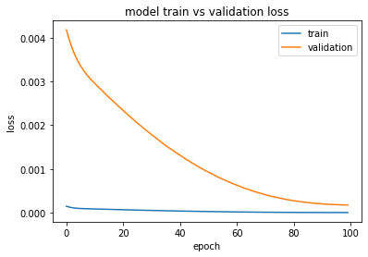
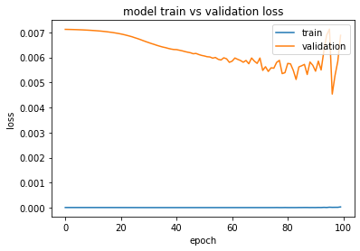
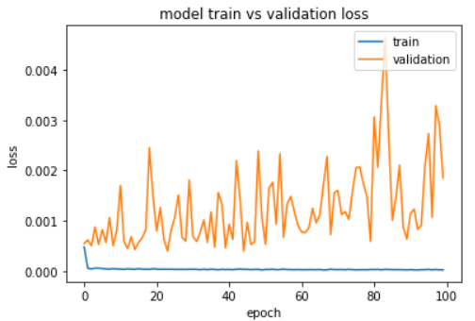
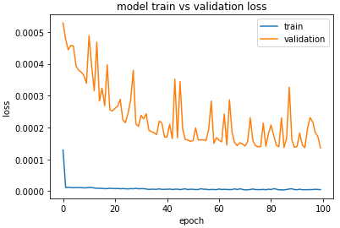
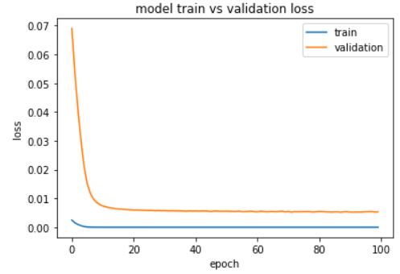
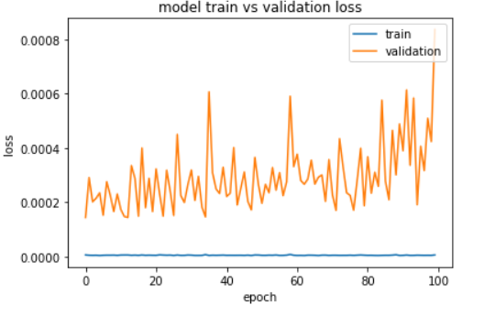
Learning curve ㇐ 2002 dataset
Linear regression (LR)
Multi layered perceptron (MLp)
Long-short term memory (lstm)
Baseline model
Baseline model
Baseline model
Tuned model
Tuned model
Tuned model
Notes:
Majority model shows an overfits, validation loss higher than training loss
Tuning does reduced the learning loss and help the validation loss started to become stable, nearer to training loss

Slide 13
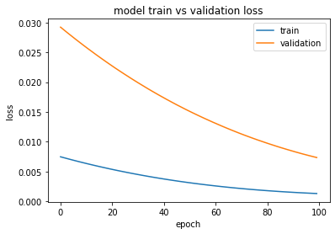
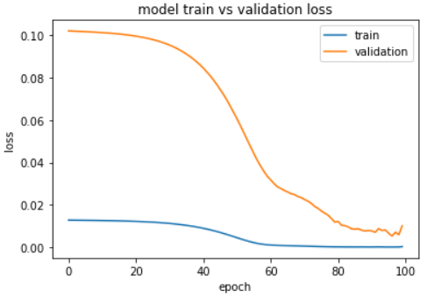
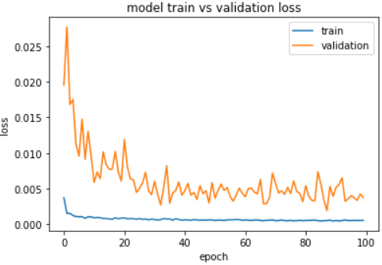
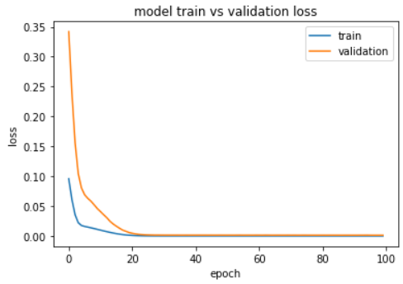
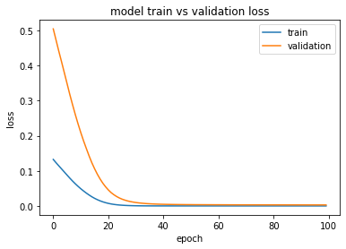
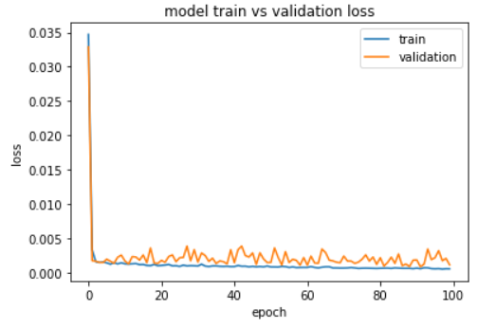
Learning curve ㇐ 2016 dataset
Linear regression (LR)
Multi layered perceptron (MLp)
Long-short term memory (lstm)
Baseline model
Baseline model
Baseline model
Tuned model
Tuned model
Tuned model
Notes:
Number of learning loss for 2016 dataset are higher than original dataset
Baseline model shows overfit as well
Tuned model makes validation loss started to get stable and converge with training loss

Slide 14
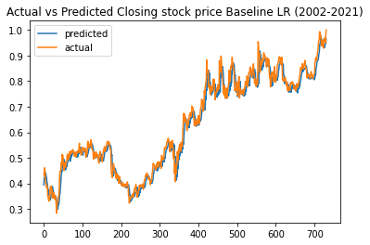
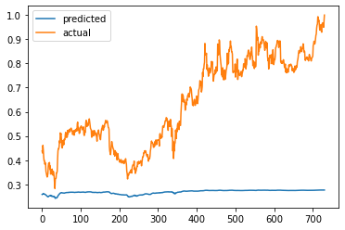
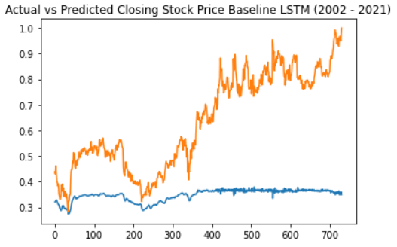
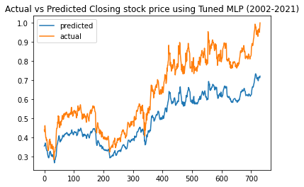
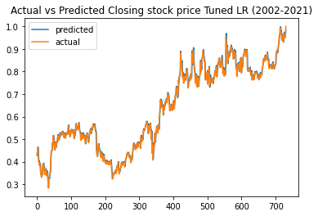
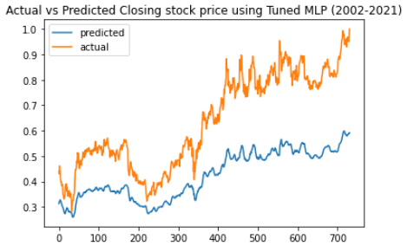
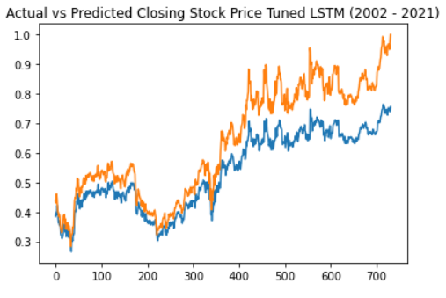
Actual vs predicted stock price ㇐ 2002 dataset
Linear regression (LR)
Multi layered perceptron (MLp)
Long-short term memory (lstm)
Baseline model
Baseline model
Baseline model
Tuned model
Tuned model
Tuned model
Notes:
LR model shows the best fit for both baseline and tuned model, followed by LSTM and MLP

Slide 15
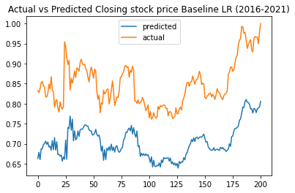
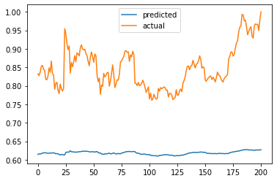
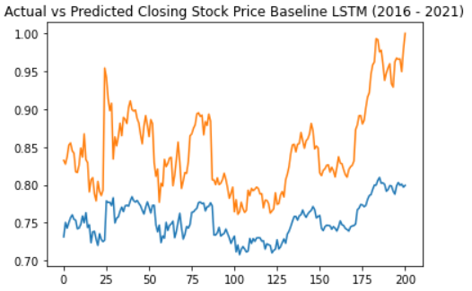
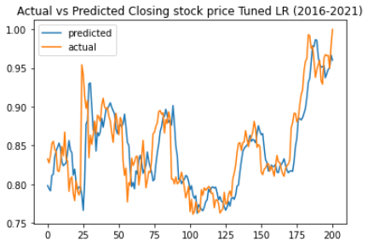
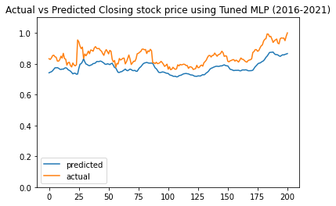
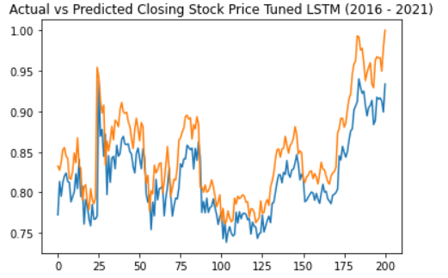
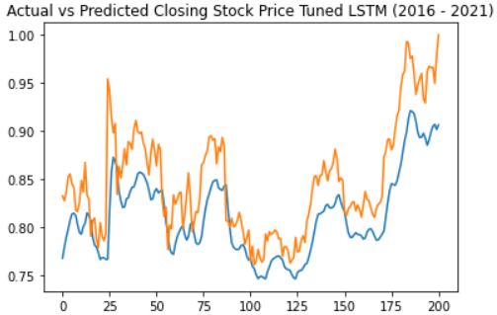
Actual vs predicted stock price ㇐ 2016 dataset
Linear regression (LR)
Multi layered perceptron (MLp)
Long-short term memory (lstm)
Baseline model
Baseline model
Baseline model
Tuned model
Tuned model
Tuned model
Notes:
Similarly, LR model shows the best fit for both baseline and tuned model, followed by LSTM and MLP

Slide 16
conclusion
Forecasting the closing stock price of an organization is a popular research domain
Traditional methods have been introduced but insufficient with the huge data size
Tuned Linear Regression model trained with original dataset had the lowest MAE & MSE of 0.0141 and 0.0004 respectively
Model performs better with more data despite its relevance
Able to adapt on different trends
Simple model works best to predict Netflix closing stock price
Future work
Multivariate Time-Series forecasting
Consider using other existing features to predict the closing price of Netflix stock
Applying hybrid models
Combining multiple models together may produce a lower error score and more accurate predictions

Slide 17


THANK YOU!
Do you have any questions?

